Slide 1
Practical 11 & 12 Configure the DHCP server and demonstrates how DHCP server assigns dynamic IP addresses to the nodes in the local network
Practical
Software required: Cisco Packet Tracer

Slide 2
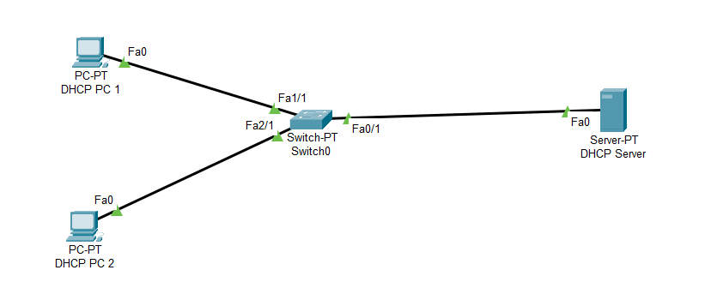
Design

Slide 3
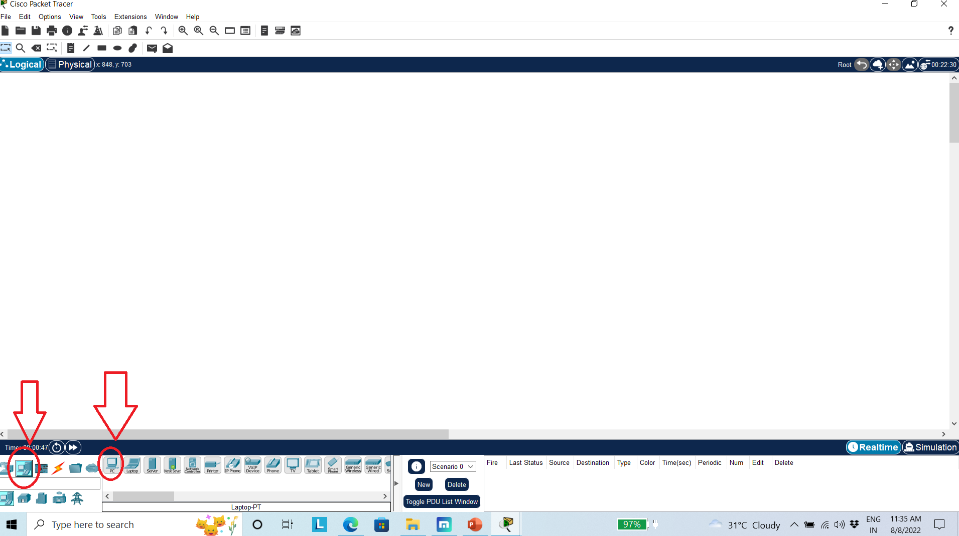
Step 1: Open Cisco Packet Tracer Tool Step 2: Select Proper option two design requires structured

Slide 4
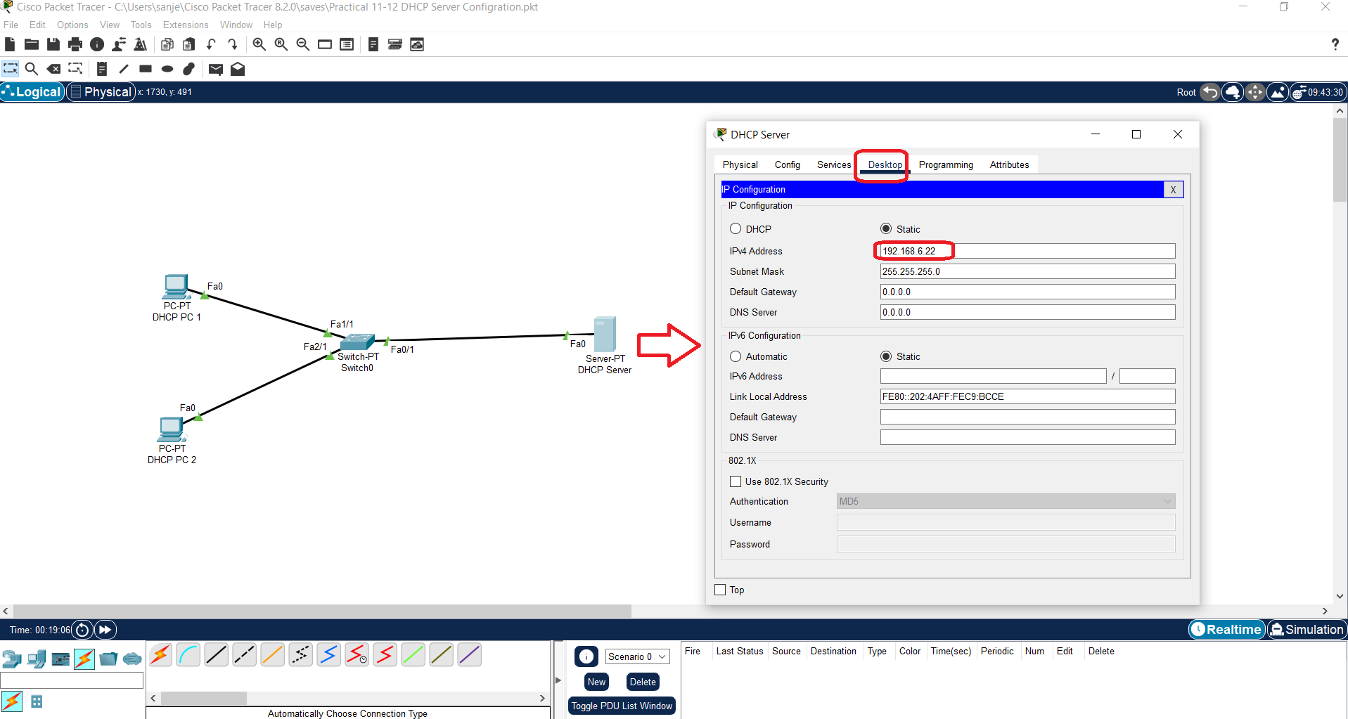
Step 3: Configure DHCP Server Step 4: Assign IP Add

Slide 5
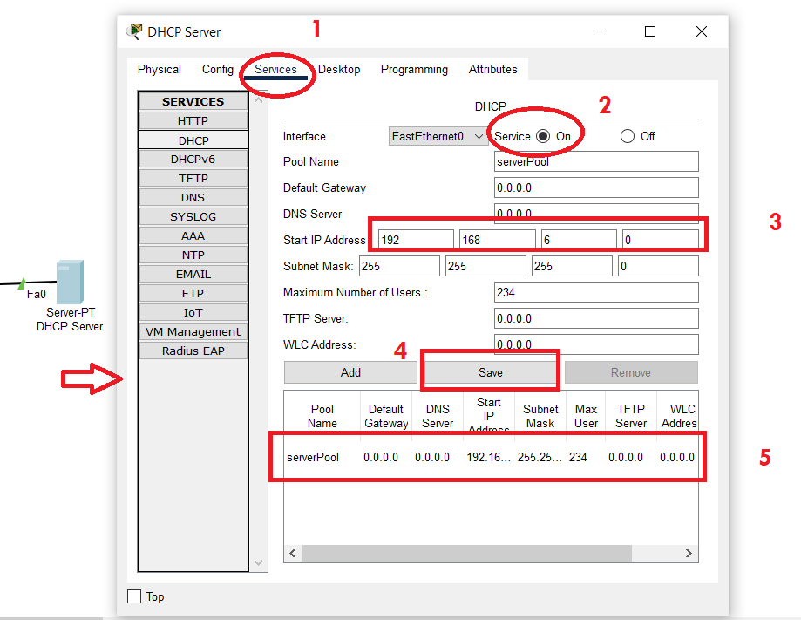
Configure DHCP Server

Slide 6
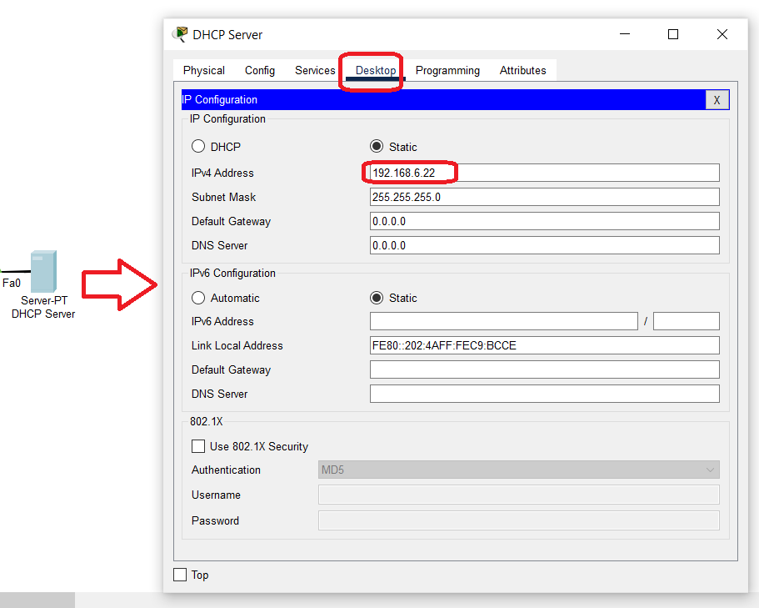
DHCP

Slide 7
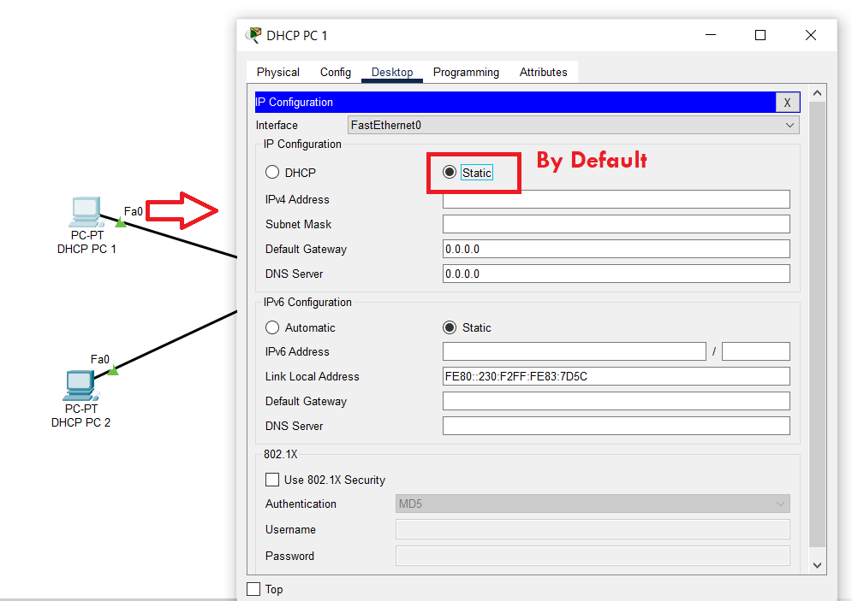
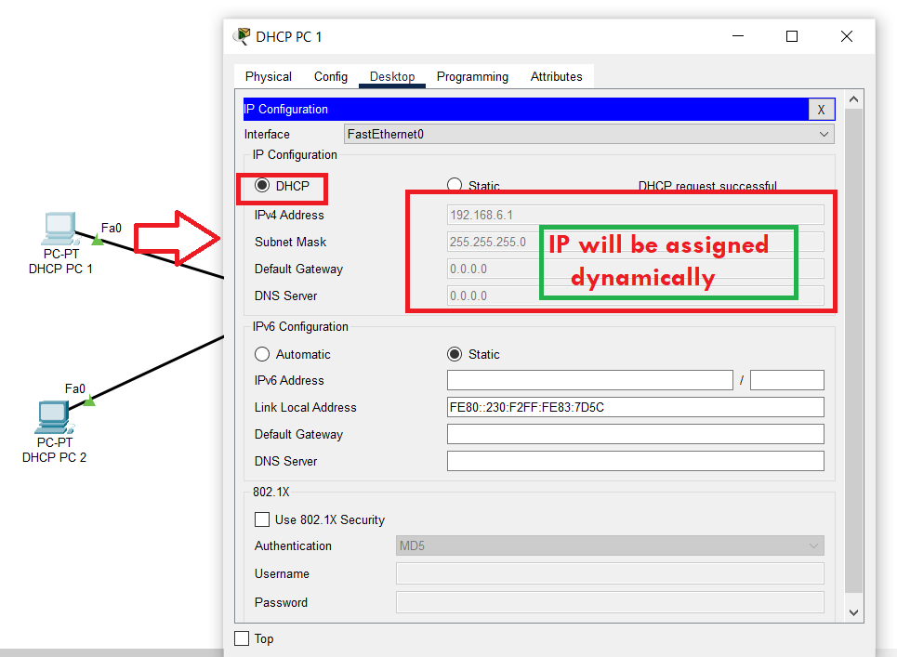
Step 5: Configure PC with DHCP Server Step 6: Change Static to DHCP

Slide 8
Configuration of DHCP with PC

Slide 9
Class Work
Configure DHCP Server
Connect 10 PC
Allocate dynamic IP’S to each PC
Display the Output

